Slide 1


ECS 271 Final Project
DEVELOP GRAPH CONVOLUTIONAL NETWORKS TO SCREEN ADSORBATES IN METAL-ORGANIC FRAMEWORKS BASED ON PORE LIMITING DIAMETERS
Group members
Sudheesh Kumar Ethirajan
Kun-Lin Wu

Slide 2
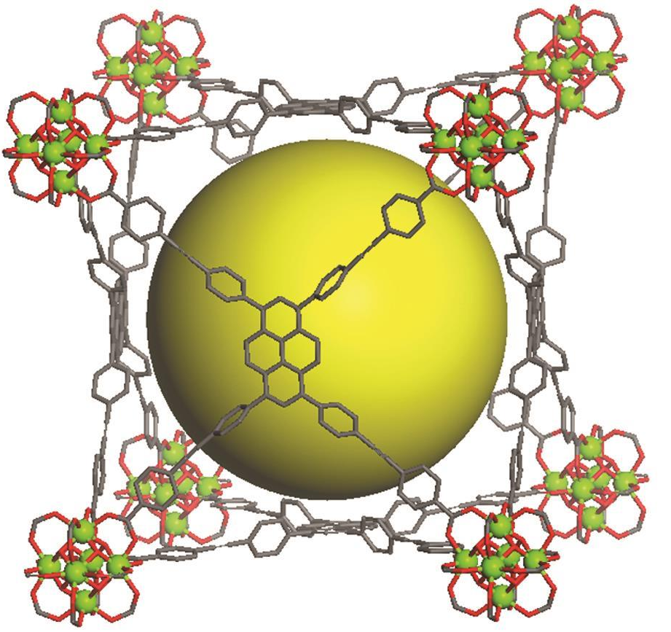
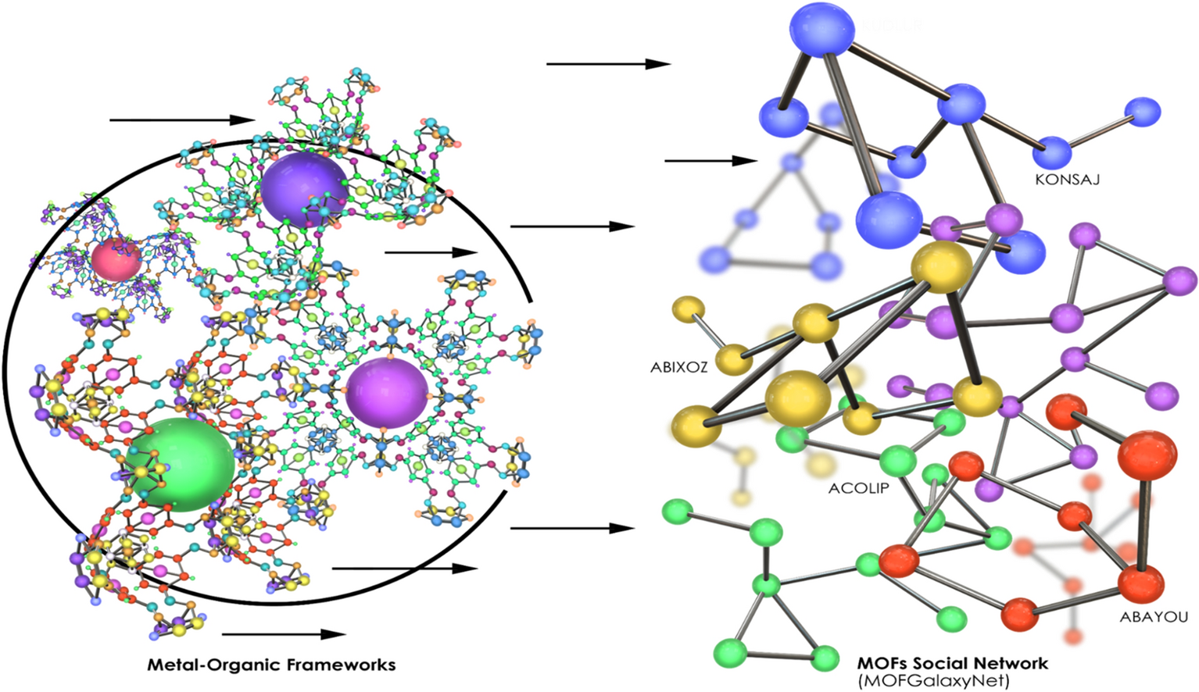
Background (Metal-Organic Frameworks - MOFs)
Nano-porous materials consisting of metal nodes & organic ligands.
Applications: gas adsorption and separation, heterogeneous catalysis, sensing, luminescence, etc.
General design criteria: Pore Limiting Diameter (PLD). Typically, computed with ZEO++ or Pore-Blazer software.
Challenge: computing the PLD for MOFs across its chemical design space is too expensive
Proposed solution: MOFGalaxyNet: a social network analysis for predicting guest accessibility in metal–organic frameworks utilizing graph convolutional networks

Slide 3
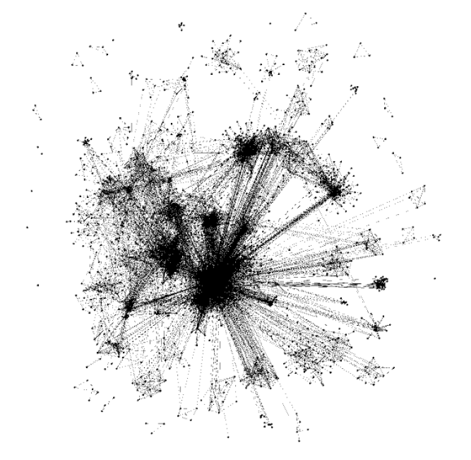
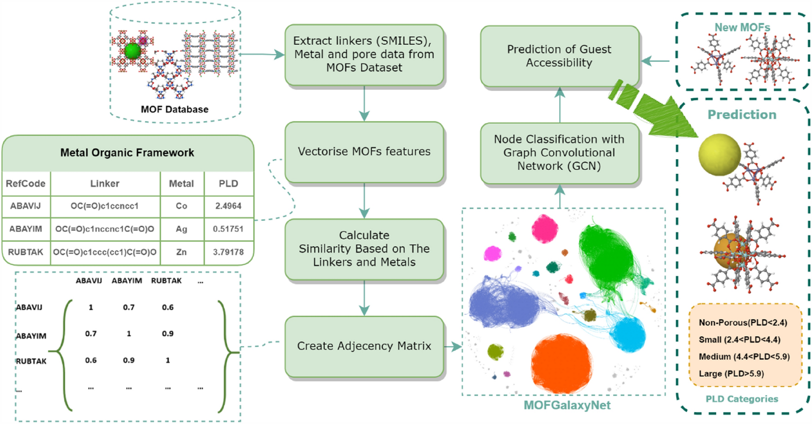
Project Workflow
MOF Social Network

Slide 4
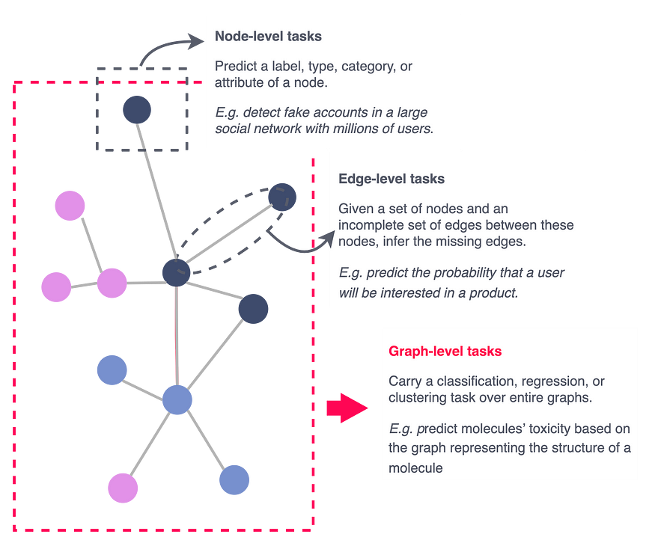
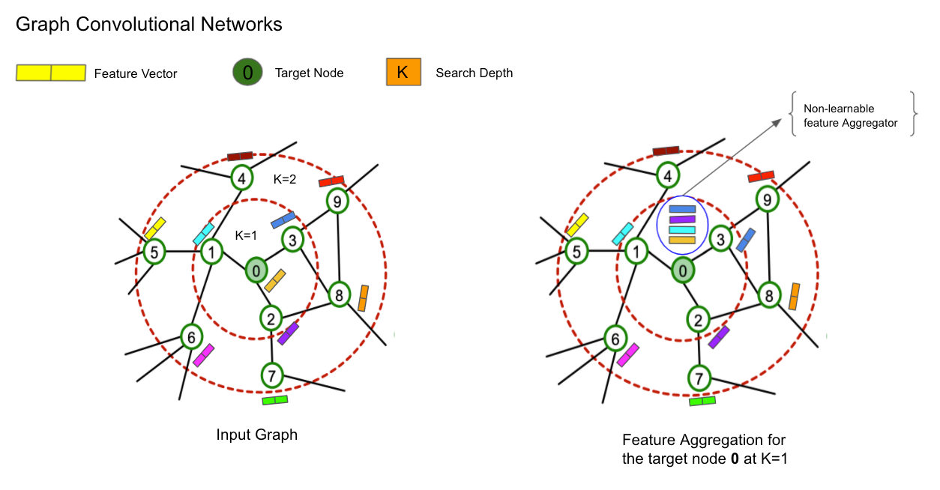
Graph Convolutional Network (GCN)

Slide 5
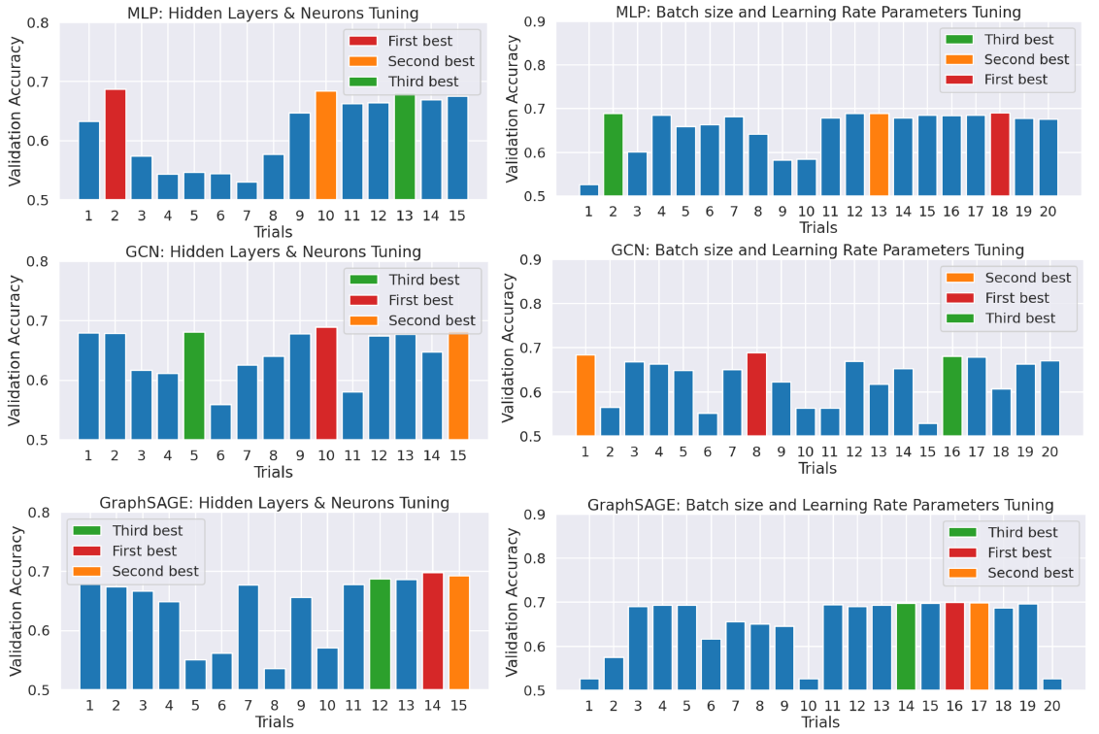
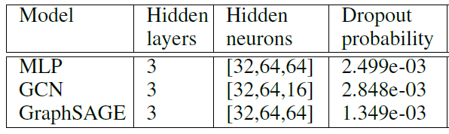
Optuna: Hyperparameter Tuning

Slide 6
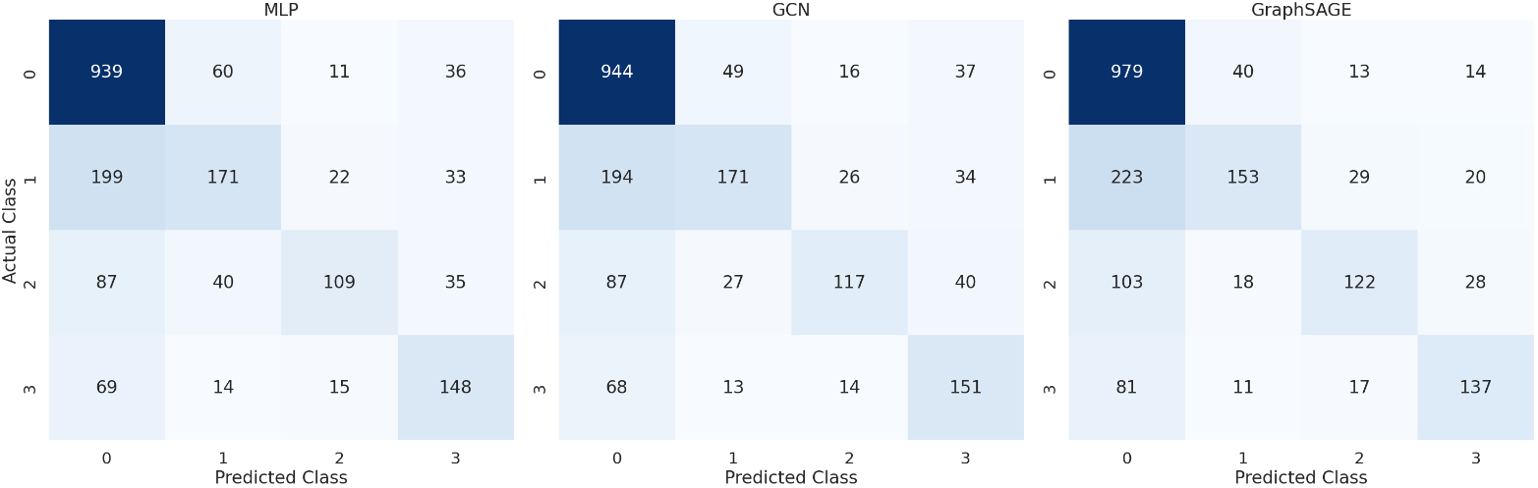
Confusion Matrices

Slide 7
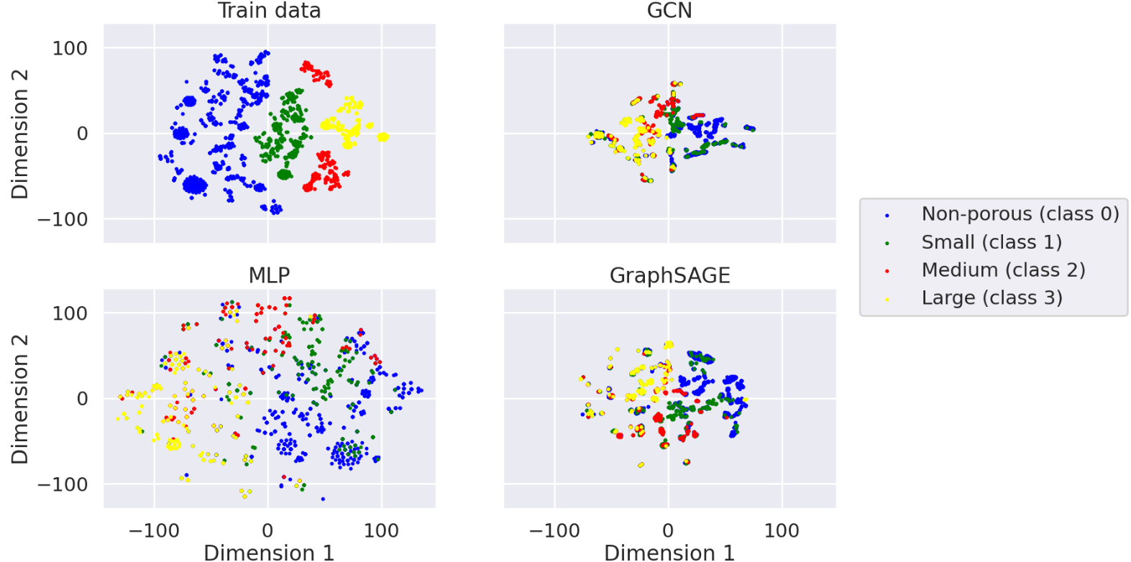
Node Embeddings with t-SNE

